Slide 1
Creating a high-performance
E-commerce Channel:
How to build it so they will come
Dean Mueller
Partner, Real Results Marketing

Slide 2
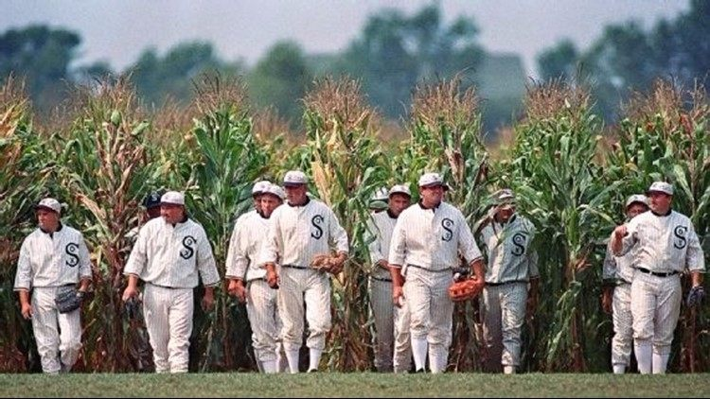
“Build It and They Will Come”

Slide 3
Agenda
Channel Tipping Point: Status of B2B E-Commerce
How do Customers Want to Shop & Buy?
E-Commerce – How to Speed Up Success
Prescriptions Based on E-Commerce Maturity
If you’d like a copy of this presentation, send email to: dean@RealResultsMarketing.com

Slide 4
Channel Tipping Point:
Status of E-Commerce

Slide 5
How Millennials Shop and Buy
Very frequent shopping methods
  40% by search
  33% at distributor website
  28% with distributor sales rep
Very frequent buying methods
  52% by email
  29% by web or mobile
  26% by CSR
Meeting Millennials where they are is key to getting their business.

Slide 6
Growing Revenue and Margin Pressures
Loss of revenue due to non-existent or inadequate
e-commerce platform
Gradual loss of revenue from manufacturers selling direct
Loss of price buyers who shift to national/global distributors
Shift of relationship buyers who become value buyers

Slide 7
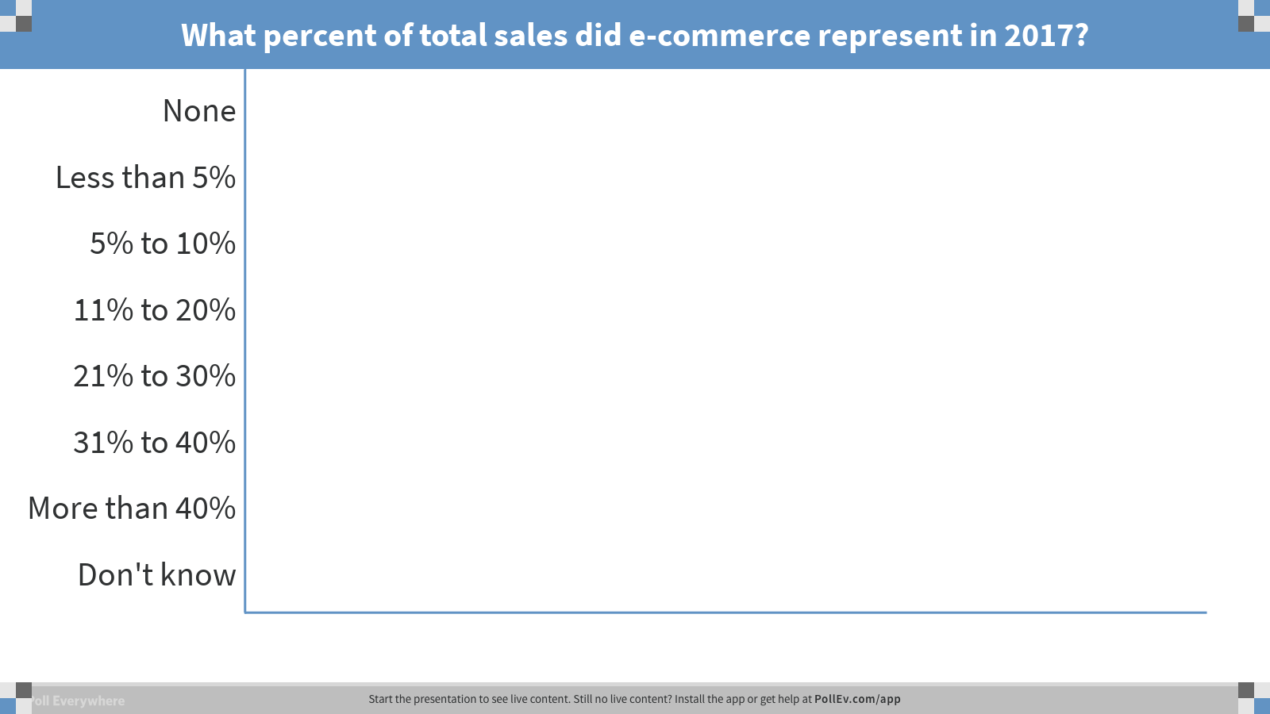
Notes:
What percent of total sales did e-commerce represent in 2017?
https://www.polleverywhere.com/multiple_choice_polls/Q6HsO0iX2scujLf

Slide 8
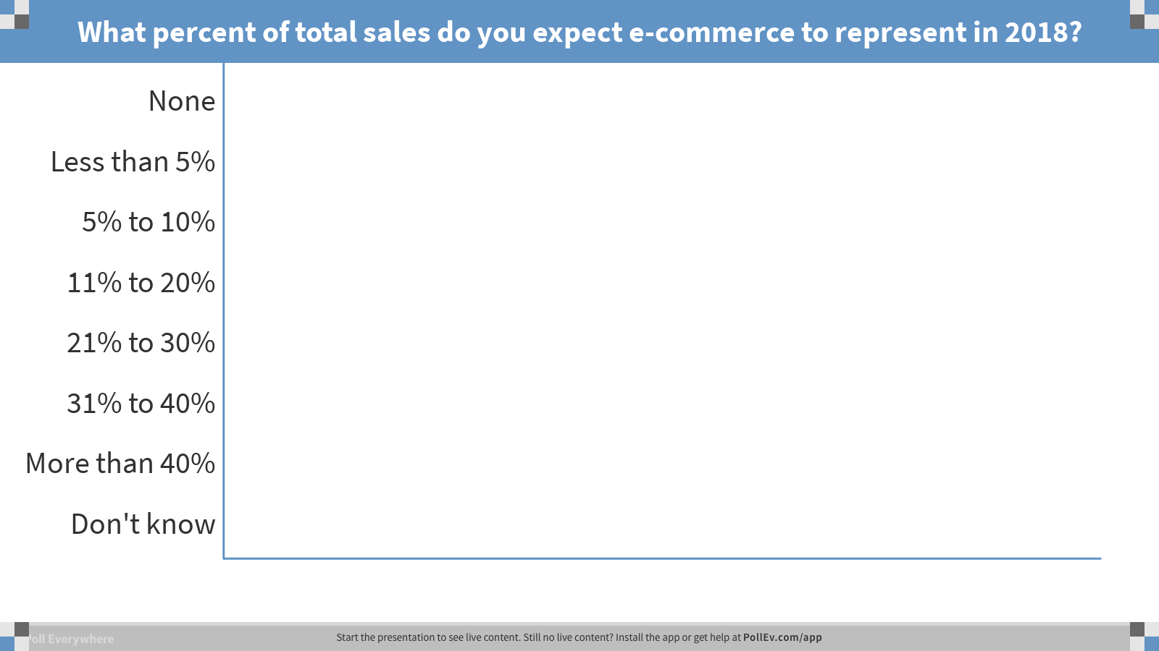
Notes:
What percent of total sales do you expect e-commerce to represent in 2018?
https://www.polleverywhere.com/multiple_choice_polls/kjbQIF0yOkqzrGp

Slide 9
By 2020 more than 60% of companies who take this survey will have 10% or more
30% will have 20% or more e-commerce revenue
ACTUAL
PROJECTED
Notes:
By 2020 more than 60% of companies who take this survey will have 10% or more
30% will have 20% or more e-commerce revenue
Moving rapidly toward winner-take-most or even winner-take-all scenario.

Slide 10
How Distributors are Affected by Amazon
42%
26%
26%
Revenue Decline
Online Investment
Price / Margin Pressure
19%
11%
10%
Logistics Invest.
KEY:
Costs Money
Makes Money
Revenue Increase
Improved Assortment
Notes:
By 2020 more than 60% of companies who take this survey will have 10% or more
30% will have 20% or more e-commerce revenue
Moving rapidly toward winner-take-most or even winner-take-all scenario.

Slide 11

When is the Tipping Point?
1 – 3 years, by 2020, depending on your industry
Moving rapidly toward winner-take-most or even winner-take-all scenario.

Slide 12
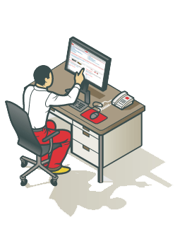
How Do Customers Want to Shop and Buy?

Slide 13
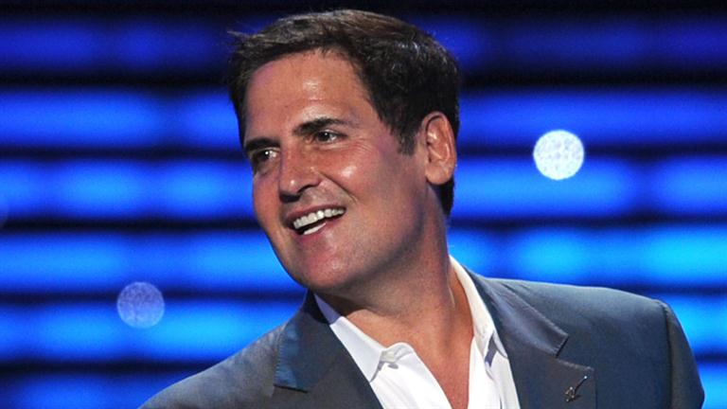
Make your product easier to buy than your competition, or you will find your customers buying from them, not you.
Mark Cuban

Slide 14
General Trends in Shopping, Buying, & Communication
Shopping
  Preference for digital and in person over print
  Shift toward search, distributor website, manufacturer website
Buying
  Strong preference for email, supplier rep by phone, website
  Nothing else is even close
  Shift toward more email, website, and mobile
Communication
  Almost 60% will receive email weekly to monthly
  Two thirds want a print catalog quarterly to annually
  35% either never want a sales rep visit or want one annually

Slide 15
Example of a Very Relational Customer Base
- Shopping has similar emphasis on search, distributor website, CSR, & Distributor Sales Rep
- Purchasing is done with people
- Significantly decreased emphasis on email and e-commerce
Shopping Preferences for Relational Customer Base
Buying Preferences for Relational Customer Base

Slide 16
Example of a Very Transactional Customer Base
- Huge emphasis on digital shopping: search websites
- Huge emphasis on digital/electronic buying: email & website
Shopping Preferences for Transactional Customer Base
Buying Preferences for Transactional Customer Base
Aversion to in-person interactions

Slide 17

KEEP CALM
EACH CUSTOMER BASE
IS DIFFERENT

Slide 18
Cost of Not Knowing Voice of Customer
Overbuilding or underbuilding e-commerce
Too many or too few sales people
Too much or too little branch infrastructure
Lost efficiencies in e-procurement, EDI, email order automation
Wrong media for the targeted generation
Passing up high margin opportunities with medium/small customers because field sales can’t or won’t service them

Slide 19
Shopping & Buying Customer Journey
If shopping is digital, top three ways to buy are:
  Email
  Website
  Supplier rep by phone
Shopping on website has only slightly higher correlation with buying on the website.
If shopping with people (CSR, DSR, MSR), top two ways to buy are:
  Email
  Supplier rep by phone
If shopping with print catalog, top three ways to buy are:
  Supplier rep by phone
  Email
  Website

Slide 20
Customer Size / Buyer Generation Matrix
Millennial/
Gen Z
Gen X
Boomer
Small
Customer
Highly
Electronic
Electronic
Hybrid
Medium
Customer
Electronic
Hybrid
Personal
Large
Customer
Highly
Personal
Hybrid
Personal

Slide 21

How to Compress Time to
E-Commerce Success

Slide 22
Understand Your Customer Segmentation:
5, 5, 15, 75…
Very large accounts ~ 5%
  3% to 6% of accounts, 70% to 85% of revenue
  Massive buying power, value added services pro bono
Large accounts – 5%
  4% to 7% of accounts, 5% to 15% of revenue
  6% to 10% higher gross margin than very large accounts
Medium accounts – 15%
  10% to 18% of accounts, 10% to 18% of revenue
  8% to 15% higher gross margin than very large accounts
Small accounts – 75%
  70% to 80% of accounts, 3% to 7% of revenue

Slide 23
Top 5 Methods for Driving Online Sales
“Also-Rans” (In order)
Pay-per-click
Print Catalog
Social Media
Marketing automation
Direct mail
Mobile Apps
People Drive Online Revenues

Slide 24
Aligning Customer Facing Personnel & E-commerce
Align compensation – Sales Reps Don’t Have “Company Hats”
Show them how it makes them more efficient and effective - WIIFM
Incent and train customer facing personnel to become evangelists and trainers
Enable CSR’s to actually take an e-commerce order on behalf of the customer

Slide 25
Inside Sales
Shift from primarily or all field sales -- add dedicated inside sales
It’s about your efficiency and your customers’: Sales calls completed in 15 mins instead of 30 to 60
Extends sales coverage to smaller accounts where outside reps don’t make financial sense
Inside sales can reach 20 to 25 customers per day at $7 to $9 per contact

Slide 26
Direct Response & E-Commerce
Where relevant, leverage print to drive e-commerce transactions
  Include icons for videos, PDF resources, etc.
  Short URLs in print pointing to product or landing page
  Highlight e-commerce benefits, e.g., self-service, 24/7 order placement, product or solutions research, etc.
Use a control group for any print flyer/catalog

Slide 27
Digital Marketing & E-Commerce
Search engine optimization (SEO)
  Start w/audit & address errors
  Develop SEO plan and continually implement
  Local SEO: optimize Google MyBusiness & Bing Places
Search engine marketing (SEM)
Email marketing and marketing automation
Social media as appropriate – test
Mobile apps if applicable to your customer base

Slide 28
EDI & Order Automation
EDI for very large customers and some large customers who are willing to incur cost of setup
Order automation for very large and large customers who like to email
Benefits
  Order accuracy improvement
  Order automation productivity benefit
  Revenue lift

Slide 29
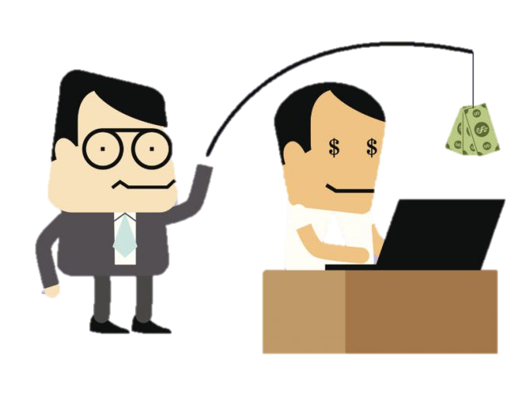
Build it So They Will Come: Create Internal Advocates
Show CSRs & Inside/Field Sales how E-Commerce helps customers AND them
  Training sessions
  One on one feature/functionality training
  Demonstrate how online orders save time and allow reps to be more consultative
  Test to ensure comprehension
  Provide incentive or SPIFF for a period of time to convert current phone, email, and fax orders to website.

Slide 30



Build it So They Will Come: Transition Customers Online
Identify key internal advocate
  Travel with salespeople to onboard key customers
  Primary point of contact for new online customers
  Create how-to-videos (create account, self-service, etc.)
  Create other step-by-step directions for accomplishing key tasks
  Make available on social media
  Webinars
  Open house or tradeshow sessions

Slide 31
Build it So They Will Come: Communication
Use digital and print to expedite
  Use email marketing effectively
    Marketing automation is underutilized in distribution
    Segment based on lifecycle, et. Al.
    Provide relevant information and engagement will increase
  Print flyers and catalogs can support digital channel
    Encourage going online to view more product data, videos, tech documents, etc.
    Initial incentives to purchase online; goal is to make online purchasing a habit
    Encourage self-service for quickest information and support

Slide 32
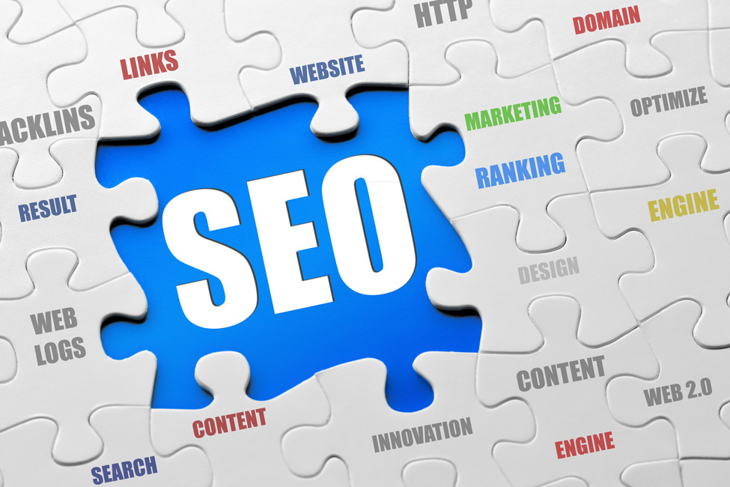
SEO → What is it?
SEO is ongoing effort to make your website visible to search engines
  Develop strategy and plan to continually feed
  Focus on most important things first
  Goal for distributor’s is ecommerce conversion, lower cost to serve, self-serve, etc.

Slide 33
SEO → What’s First?
Fix site first
  Ensure site is fast & page load speeds
  Mobile optimized
Conduct site audit (benchmark for future)
  Identify & fix technical errors
  Missing title tags, etc.

Slide 34
SEO Site Audit Parameters
 | YOURSITE.COM
Crawl site – scan all resources, Javascript, CSS, images, video, etc. | √
Check for crawling and/or Indexing Issues - Sitemap - Robots.txt Identify errors | √
Identify redirect mistakes 302 redirects Meta refresh Canonical | √
Identify HTML/CSS markup errors | √
Find broken backlinks | √
Review & identify tag issues Long or empty title/meta descriptions Duplicate title/meta descriptions Header tag H1 | √
Content optimization Identify thin/sparse content Site images w/alt tags | √
Keyword positions & competitive overview | √

Slide 35




Example Site Audit Summary
ERRORS
4xx status codes 143
5xx status code 1
Broken images 2
Empty title tags 2
Duplicate titles 143
Duplicate
meta description 842
WARNINGS
Dynamic URLs 28,784
Too long URLs 16,291
Broken links 168
Too long titles 12,261
Empty meta
description 12,727
Too long meta
description 22,996
INFORMATION
Restricted from index 18,831
Pages w/301 redirect 4,725
Pages with
rel=“canonical” 45,911
Pages w/W3C HTML
errors and warnings 492
Pages w/W3C CSS
errors and warnings 49,975
Empty alt text 50,061
Pages w/excessive
number of links 45,911
Dofollow external
links 383,519
OK!
404 page set up correctly
robots.txt file YES
.xml sitemap YES
Issues w/HTTP/HTTPS
site versions NO
Pages w/302 redirect 0
Pages w/long
redirect chains 0
Pages w/meta refresh 0
Mobile friendly YES
Pages w/multiple
canonical URLs 0
Pages with frames 0
Too big pages 0
1,133
93,227
599,425

Slide 36
SEO → Keyword Strategy
Ranking higher in Google (or your favorite search engine) means when keywords or a phrase is entered you want to come up in the SERP (search engine results page)
Use tools to generate keyword ideas
  Develop a keyword strategy using Google Keyword Planner, part of AdWords, or other tool
  Identify negative keywords if using PPC campaigns to minimize paying for non-relevant clicks

Slide 37
SEO → Content
Product data is just the start
  Differentiate between all other sites that have the same product data
  Top product descriptions are continually tweaked
  Ideal rule of thumb is 300 words minimum of content, which is often hard to do on a product detail page. This is where you differentiate yourself from your competition.

Slide 38
Local SEO
Optimize for branches or multiple locations
Consistent NAP (name, address, phone) across every mention of your site and any directories or listings.
  (555) 555-1515 is different in Google’s view than 515.555.1515 or 555-555-1515.
  Local SEO is major way to leverage your uniqueness and differentiate.
  Google results are dependent upon WHERE a search is coming from and also what type of device used
  Best URL practice: distributor.com/locations/orlando-fl

Slide 39
SEO → When Am I Done?
SEO is a competition. Forever.
3.4 months is estimated average time for targeted content to appear high up in search results
Thousands of factors shift timeframe and results, which will vary from person to person, by geography, by device, etc.
While search engines change all the time, the fundamentals are generally the same.
Continually review analytics and adjust.

Slide 40
Inbound/Outbound Considerations
Content plan: both product data + relevant information
SEO strategy: develop and follow plan, including SEO audit
Proactive inside sales
  Handle high opportunity accounts not served (well) by field sales
  Current customers
  Targeted prospects that are similar to your most profitable customers
Digital/Print flyers to drive conversions

Slide 41


Slide 42
Prescriptions Based on
E-Commerce Maturity

Slide 43

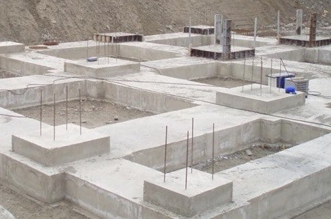
Nascent: < 5% E-Commerce
Lay the foundation
Complete a customer profile. Where are your profitable sweet spots?
Understand how your customers want to shop (find & select) and buy products.
Have a clear value proposition. How do you differentiate from your competitors?
Develop demand generation strategy, including inbound/outbound components.
Create SEO strategy and plan. Start with SEO audit, then systematically optimize content.
Test and measure activities to continually adjust and optimize.
Customer Profile -
Sweet Spot
SEO plan
Audit & Content
Shopping & Buying Survey
Clear
Value Proposition

Slide 44
Growth: 5% to 10% E-Commerce
Build up from foundation
Ensure foundation is solid. Complete, update, or adjust as needed.
Develop & implement SEM plan. Search engine marketing (PPC) can be important growth drivers.
Begin modifying key product content as possible to increase likelihood of being found in search engines. Prerequisite is solid value proposition to focus content on what is important for your customers.
Consider landing pages or other content that appeals to key customer segments.
Optimize Local SEO. Often overlooked, but good opportunity to increase awareness and business at the local branch level.
UX Improvements – persona journey mapping, etc.
Evaluate/implement proactive inside sales. Solid e-commerce initiative and content supports offline activities.

Slide 45
Maturity: 10% to 20% E-Commerce
Build additional levels
Ensure foundation is solid. Complete, update, or adjust as needed.
Continually test, measure, and adjust activities.
UX Improvements – persona journey mapping, etc.
Optimize SEO. FYI – this NEVER stops.
Evaluate punchout integration with ERPs. If not already considered, understand what customers may need or desire punchout capabilities. Generally the largest customers, but ease of implementation is opening up new opportunities to be extremely sticky with customers and make the barrier to leave you high.
Aggressively implement SEM activities to solidify current customers and open up new markets.

Slide 46
Leader: > 20% E-Commerce
Maintain and expand
Ensure foundation is solid. Complete, update, or adjust as needed.
Continually test, measure, and adjust activities.
UX Improvements – journey mapping, etc.
Optimize SEO. FYI – this NEVER stops.
Implement personalization strategies, if not already completed.
You Get to Speak at the next conference.

Slide 47
About Real Results Marketing
Specialize in marketing analysis, strategy and execution for distributors and manufacturers.
Employ highly-experienced and team-oriented consultants with experience working in corporations.
Focus on making marketing into a profit center.
Deliver best results with customers who start with understanding the marketplace, developing strategies and then implementing and measuring them.
Deliver maximum value with every contract. We make ourselves highly available for our clients - feel free to contact us with your strategy or marketing questions any time.

Slide 48
Real Results Marketing Services
E-commerce and digital marketing strategy
  Syndicated survey is the foundation for customer feedback
Demand generation and profit improvement
Positioning and messaging
Market research
Marketing infrastructure development

Slide 49
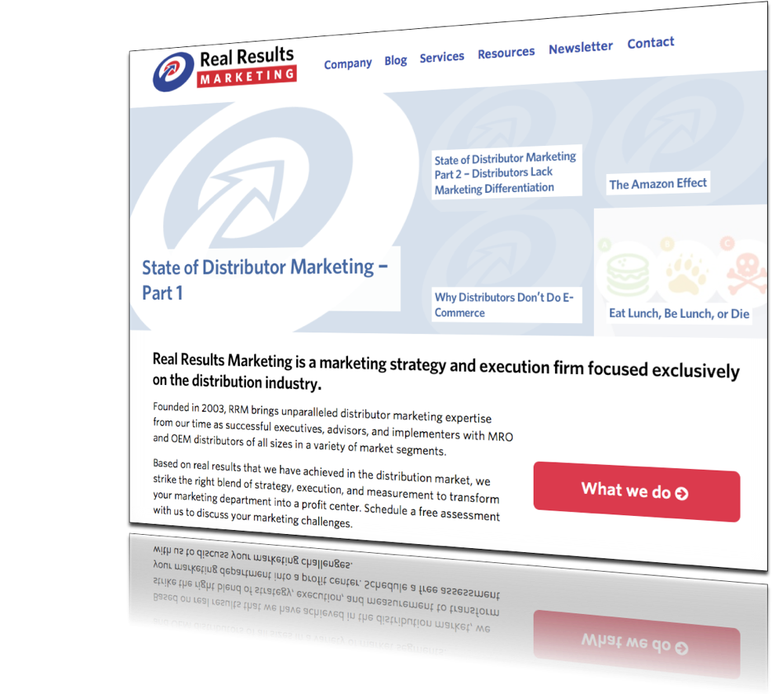

Talk to Us!
Dean Mueller
dean@realresultsmarketing.com
303-898-8636
RealResultsMarketing.com

